Slide 1
Collection of Fines and Fees
Presented To:
The Advisory Commission On The Administration Of Justice’s Victims Of Crime Sub-Committee
Presented By:
Steven D. Grierson
Court Executive Officer
Eighth Judicial District Court

Slide 2
Criminal Fines & Fees
NRS | Description | Amount
176.062 | Administrative Assessment Fee | $ 25.00
19.03135 | Genetic Marker Analysis AA Fee | $ 3.00
200.485 | AA Fee Battery DV (STATE) | $ 35.00
453.5750 | Drug Analysis Fee (METRO) | $ 60.00
484C.510 | DUI Chemical Analysis Fee (METRO) | $ 60.00
176.1110 | DNA Analysis Fee (METRO) | $ 150.00
206.340 | Graffiti Reward Account AA | $ 250.00
176.0850 | FINE (STATE) 73299947011009STAFINE | Per Judge
Court | Indigent Defense Civil Assessment Fee | Per Judge

Slide 3
OFFICIAL FEES FOR THE EIGHTH JUDICIAL DISTRICT COURT Effective October 1, 2013
NRS | Description | Amount
Adoptions | When filing a new Adoption proceeding NRS 19.013 ($56), 19.020 ($3), 19.031 ($25), 19.0312 ($10), 19.0313 ($10), 19.0315 ($15), AB 65 ($99), CCC 2.32 ($20) | $ 238.00
 | When filing a new Adoption proceeding for a special needs child pursuant to NRS 19.034 | $1.00
Answer or Appearance | When a defendant/respondent answers (files a first appearance to) a Complaint/Petition; to be paid upon the filing of the first paper in the action for Civil cases and Domestic cases not contained in NRS 125 NRS 19.013 ($44), 19.031 ($25), 19.0312 ($10), 19.0313 ($10), 19.0315 ($15), AB 65 ($99), CCC 2.32 ($20) | $223.00
 | For each additional defendant named in a civil answer or first appearance (See *Examples on page 3) NRS 19.0335 ($30) | $30.00
 | When a defendant answers an action for constructional defect or any other action defined as complex NRS 19.013 ($44), 19.031 ($25), 19.0312 ($10), 19.0313 ($10), 19.0315 ($15), AB 65 ($349), CCC 2.32 ($20) | $473.00
 | When a defendant answers a business court filing NRS 19.013 ($44), 19.031 ($25), 19.0312 ($10), 19.0313 ($10), 19.0315 ($15), AB 65 ($1,359), CCC 2.32 ($20) | $1,483.00
 | Divorce, Annulment, Separate Maintenance answer or first appearance NRS 19.013 ($44), 19.031 ($14), 19.0312 ($10), 19.0313 ($10), 19.0315 ($15), CCC 2.32.030 ($5), AB 65 ($99), CCC 2.32 ($20) | $217.00
 | Child Custody answer or first appearance NRS 19.013 ($44), 19.031 ($14), 19.0313 ($10), 19.0315 ($15), 19.0312 ($10) AB 65 ($99), CCC 2.32 ($20) | $212.00
Appeal from a Justice or Municipal Court | When filing an appeal from a Justice Court or Municipal Court NRS 19.013 ($42), 19.020 ($5) | $47.00
Appeal/Supreme Court | When filing a Notice of Appeal NRS 19.013 ($24) | $24.00
 | Bonds for Costs on Appeal | $500.00
 | Supreme Court Appeal filing fee (payable to the Clerk of the Supreme Court) | $250.00
Complaints Annulment or Separate Maintenance | When filing a Complaint for Annulment or a Complaint for Separate Maintenance NRS 19.013 ($56), 19.020 ($3), 19.030 ($32), 19.031 ($14), 19.0312 ($10), 19.0313 ($10), 19.0315 ($15), 440.605 ($10), AB 65 ($99), CCC 2.32 ($20) | $269.00
Child Custody | When filing a Complaint for Child Custody NRS 19.013 ($56), 19.020 ($3), 19.030 ($32), 19.031 ($14), 19.0312 ($10), 19.0313 ($10), 19.0315 ($15), AB 65 ($99), CCC 2.32 ($20) | $259.00
Civil | When filing a new Civil action or proceeding NRS 19.013 ($56), 19.020 ($3), 19.030 ($32), 19.031 ($25), 19.0312 ($10), 19.0313 ($10), 19.0315 ($15), AB 65 ($99), CCC 2.32 ($20) | $270.00
 | When filing a Complaint in Interpleader (when new Civil action) NRS 19.013 ($56), 19.020 ($3), 19.030 ($32), 19.031 ($25), 19.0312 ($10), 19.0313 ($10), 19.0315 ($15), AB 65 ($99), CCC 2.32 ($20) | $270.00

Slide 4
OFFICIAL FEES FOR THE EIGHTH JUDICIAL DISTRICT COURT Effective October 1, 2013
NRS | Description | Amount
Civil (cont.) | When filing an action for constructional defect or other action defined as complex NRS 19.013 ($56), 19.020 ($3), 19.030 ($32), 19.031 ($25), 19.0312 ($10), 19.0313 ($10), 19.0315 ($15), AB 65 ($349), CCC 2.32 ($20) | $520.00
 | When filing a business court matter NRS 19.013 ($56), 19.020 ($3), 19.030 ($32), 19.031 ($25), 19.0312 ($10), 19.0313 ($10), 19.0315 ($15), AB 65 ($1,359), CCC 2.32 ($20) | $1,530.00
 | For each additional plaintiff named in a civil complaint or amended civil complaint for any of the case types above (See *Examples on page 3) NRS 19.0335 ($30) | $30.00
 | When filing Request for Foreign Deposition Subpoena(s) NRS 19.013 ($56), 19.020 ($3), 19.030 ($32), 19.031 ($25), 19.0312 ($10), 19.0313 ($10), 19.0315 ($15), AB 65 ($99), CCC 2.32 ($20) | $270.00
 | When filing Application for Foreign Judgment NRS 19.013 ($56), 19.020 ($3), 19.030 ($32), 19.031 ($25), 19.0312 ($10), 19.0313 ($10), 19.0315 ($15), AB 65 ($99), CCC 2.32 ($20) | $270.00
 | When filing a transfer to business court after filing as a general civil action | $1,260.00
 | When filing a third party complaint AB 65 ($135) | $135.00
Divorce | When filing for a Divorce NRS 19.013 ($56), 19.020 ($3), 19.030 ($32), 19.031 ($14), 19.0312 ($10), 19.0313 ($10), 19.0315 ($15), 19.033 ($20), 440.605 ($10), AB 65 ($99), CCC 2.32 ($20) | $289.00
Domestic Not Specified Above | When filing a domestic case not specified above NRS 19.013 ($56), 19.020 ($3), 19.030 ($32), 19.031 ($25), 19.0312 ($10), 19.0313 ($10), 19.0315 ($15), AB 65 ($99), CCC 2.32 ($20) | $270.00
Confession of Judgment | For filing a Confession of Judgment NRS 17.110 ($28) | $28.00
Domestic Case-Reopen | When filing a motion or other paper that seeks to modify or adjust a final order issued pursuant to NRS 125, 125B and 125C and on filing any answer or response to such a motion or other paper, excluding those exceptions noted in NRS 19.0312. (effective 11/04/02) | $25.00
Liens, Frivolous or Excessive | When filing an application regarding frivolous or excessive liens NRS 19.020 ($3), 19.030 ($32), 19.031 ($25), 19.0312 ($10), 19.0313 ($10), 19.0315($15), 108.2275 ($85) AB 65 ($99), CCC 2.32 ($20) | $299.00
Minor’s Compromise | When filing a Petition to Compromise a Minor’s Claim NRS 41.200 | NO FEE
Miscellaneous Filings | To file other papers to be kept by the clerk, except for papers filed in court or filed by public officers in their official capacity, and not otherwise provided for NRS 19.013 ($5), 19.020 ($3), 19.0313 ($10) | $18.00
 | For issuing any certificate under seal, not otherwise provided for NRS 19.013 ($6) | $6.00
Motions | For filing a motion for summary judgment or joinder AB 65 ($200) | $200.00
 | For filing a motion to certify/decertify class AB 65($349) | $349.00
Peremptory Challenge | Peremptory challenge of a Judge (payable to the Clerk of the Supreme Court) | $450.00

Slide 5
OFFICIAL FEES FOR THE EIGHTH JUDICIAL DISTRICT COURT Effective October 1, 2013
NRS | Description | Amount
Petitions | When filing a new Petition (see examples below) NRS 19.013 ($56), 19.020 ($3), 19.030 ($32), 19.031 ($25), 19.0312 ($10), 19.0313 ($10), 19.0315 ($15), AB 65 ($99), CCC 2.32 ($20) Examples: Petition to Seal Records; Petition for Writ of Mandamus; Petition for Writ of Habeas Corpus; Petition for Appointment of Guardian Ad Litem; Civil Petition for Judicial Review; Petition for Judicial Review (Foreclosure Mediation); Miscellaneous Petitions | $270.00
 | Petition for Approval of a Minor Contract (designated a Business Court case) NRS 19.013 ($56), 19.020 ($3), 19.030 ($32), 19.031 ($25), 19.0312 ($10), 19.0313 ($10), 19.0315 ($15), AB 65 ($1,359), CCC 2.32 ($20) | $1530.00
 | For each additional petitioner named in a civil petition or amended civil petition (See *Examples on page 3) NRS 19.0335 ($30) | $30.00
Probate/Guardianship | When filing a petition for letters testamentary or administration or guardianship where the stated value of the estate is $20,000 or less NRS 19.013 | NO FEE
 | Where the stated value of the estate is more than $20,000 but less than $200,000 NRS 19.013 ($72), 19.020 ($3), 19.030 ($32), 19.031 ($25), 19.0312 ($10), 19.0313 ($10), 19.0315 ($15), AB 65 ($99), CCC 2.32 ($20) | $286.00
 | Where stated value of the estate is $200,000 or more NRS 19.013 ($72), 19.020 ($3), 19.030 ($32), 19.031 ($25), 19.0312 ($10), 19.0313 ($10), 19.0315 ($15), AB 65 ($352), CCC 2.32 ($20) | $539.00
 | When filing a petition to contest any will or codicil, or on the filing of an objection or cross-petition to the appointment of an executor, administrator or guardian or an objection to the settlement of account or any answer in an estate or guardianship matter NRS 19.013 ($44), 19.031 ($25), 19.0312 ($10), 19.0313 ($10), 19.0315 ($15), AB 65 ($99), CCC 2.32 ($20) | $223.00
Transfer from another District Court or County | To transfer an action or proceeding from another District Court or County NRS 19.013 ($56), 19.020 ($3), 19.030 ($32), 19.031 ($25), 19.0312 ($10), 19.0313 ($10), 19.0315 ($15), AB 65 ($99), CCC 2.32 ($20) | $270.00
Transfer from a Justice or Municipal Court | When transferring a case from a Justice Court or Municipal Court NRS 19.013 ($42) | $42.00
Will | When filing an original Will NRS 19.013 ($5), 19.020 ($3), 19.0313 ($10) | $18.00
Writs | For the issuance of any writ of attachment, writ of garnishment, writ of execution or any other writ designed to enforce any judgment of the court AB 65 ($10) | $10.00
Copies | For each page copied from any document(s) NRS 19.013 (¢.50) | ¢0.50
Certify/Exemplify | To certify copies of any document(s) prepared by the clerk NRS 19.013 ($3) | $3.00
(Copy fees of ¢0.50 per page also apply) | To exemplify any document(s) prepared by the clerk per page also apply) NRS 19.013 ($6) To examine and certify a copy of any document(s) prepared by another NRS 19.013 ($5) To examine and exemplify a copy of any document(s) prepared by another | $6.00 $5.00 $9.00
Qualifying Powers | To file Qualifying Powers | $15.00
Searches | For performing a search of the records per year, per name | ¢0.50
Statement of Domiciles | To file a Statement of Domicile NRS 41.195 ($5) | $5.00

Slide 6
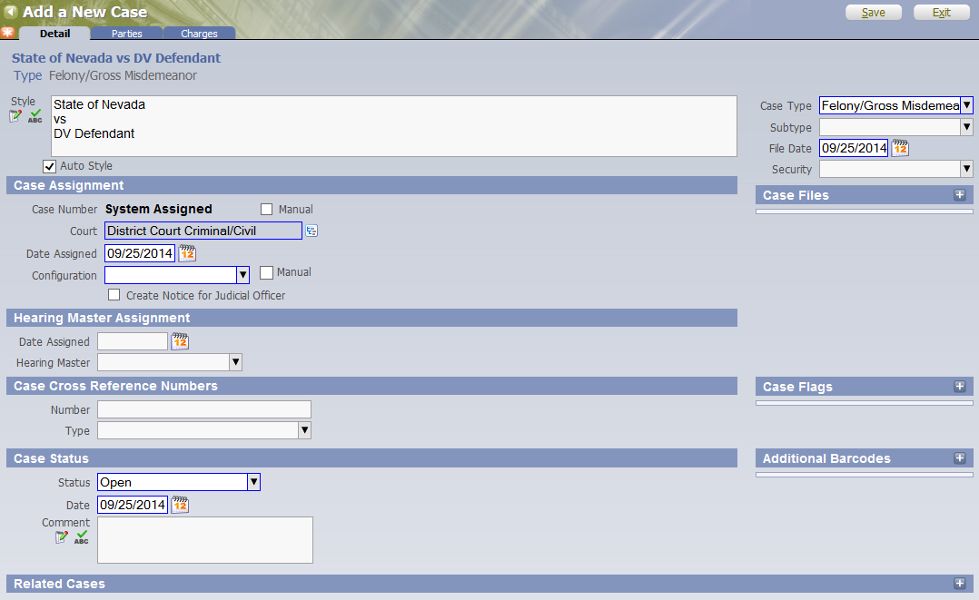
Criminal Case Flow
Case Filed

Slide 7
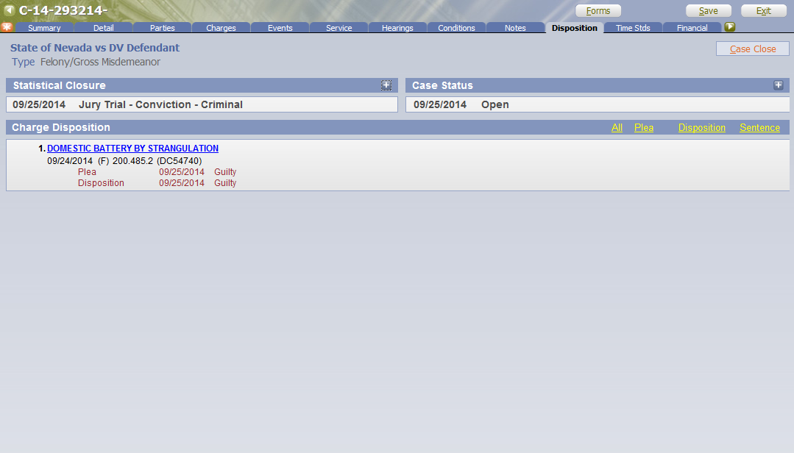
Criminal Case Flow
Sentenced

Slide 8
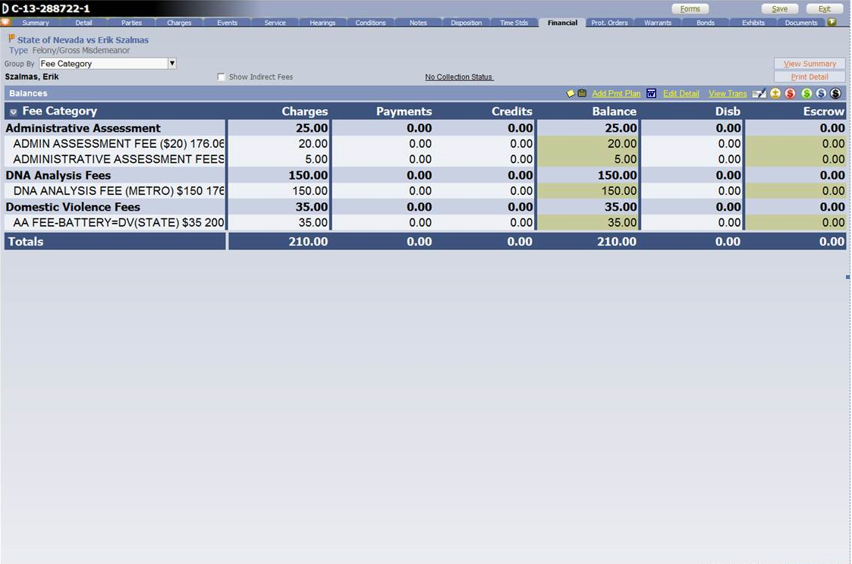
Criminal Case Flow
Fines & Fees Imposed

Slide 9
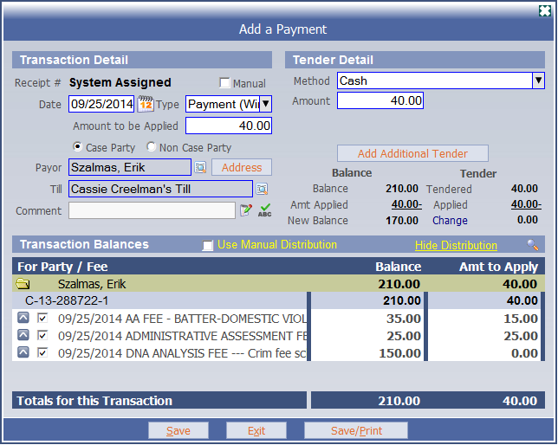
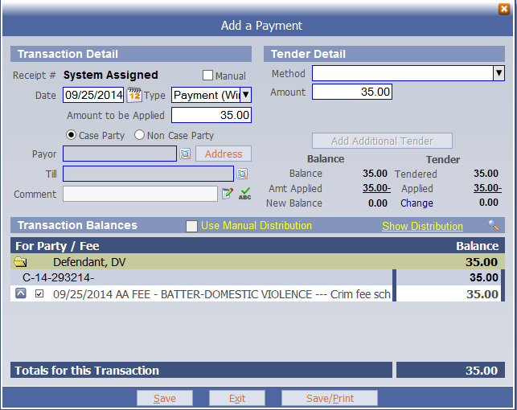
Criminal Case Flow
Payment

Slide 10
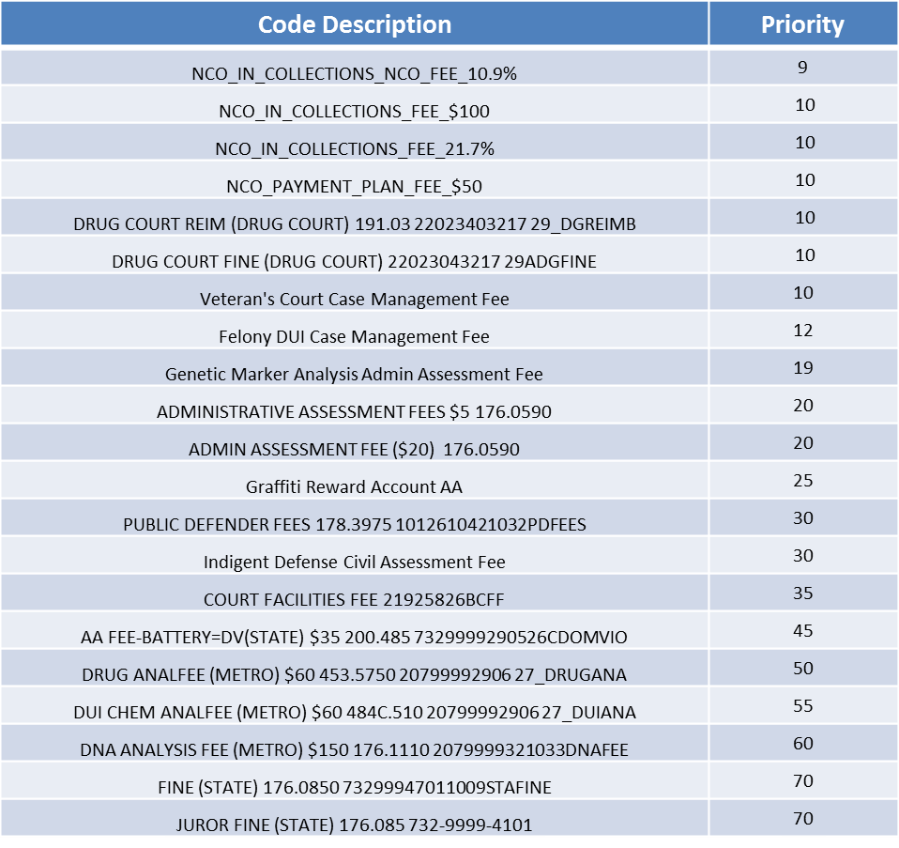
Criminal Case Flow
Criminal Fee Priorities

Slide 11
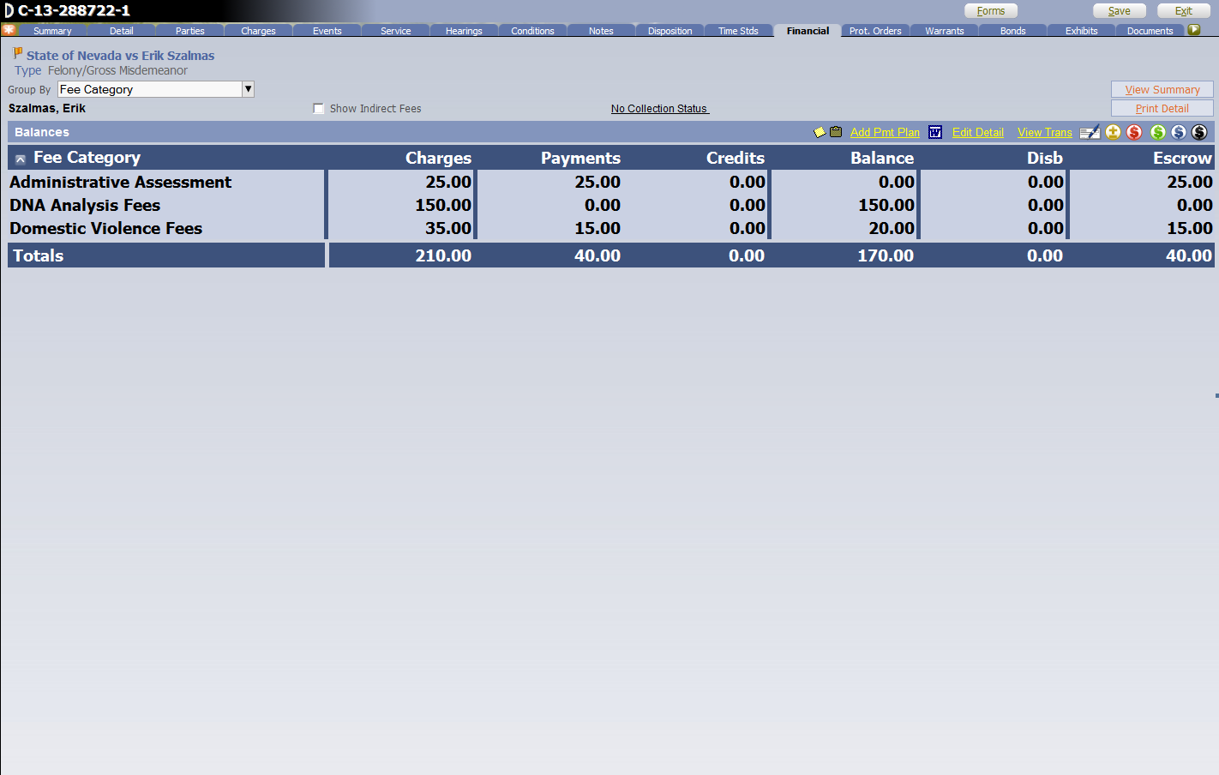
Criminal Case Flow
Escrow

Slide 12
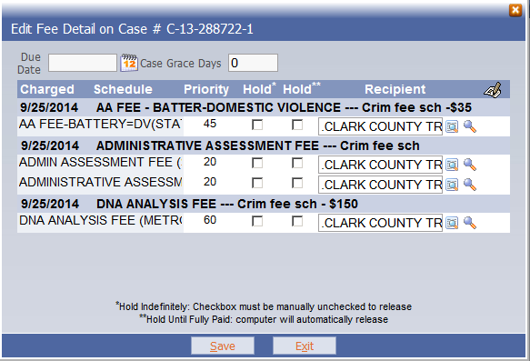
Criminal Case Flow
Priority of Distribution

Slide 13
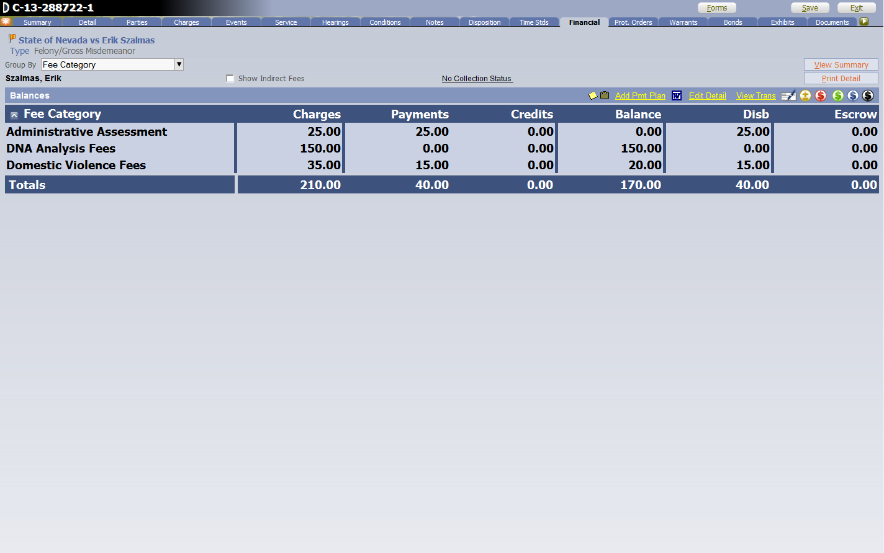
Criminal Case Flow
Disbursement

Slide 14
Revenue Transmittal: July 2014
NRS | Description | Civil Odyssey | Criminal Odyssey | Family Odyssey | Total
19.013 | MISCELLANEOUS CLERK FEES | 88,984.50 | 2,317.41 | 83,290.02 | 174,591.93
19.013 | TVS – MISCELLANEOUS CLERK FEES |  |  | 3,011.15 | 3,011.15
N/A | ACCOUNTS PAYABLE REFUND REQUEST | (767.47) |  | (1,034.00) | (1,801.47)
19.0302 | DC COURT SPECIAL FILING FEE | 326,901.00 |  | 177,820.40 | 504,721.40
19.0303 | DC SECURITY FEE | 45,020.00 |  | 36,715.59 | 81,735.59
19.0335 | GENERAL TECHNOLOGY FEES | 5,616.00 |  |  | 5,616.00
176.062 | ADMINISTRATION ASSESSMENT – COUNTY |  | 830.51 |  | 830.51
19.03135 | ARBITRATION PROGRAMS | 33,765.00 |  | 27,536.70 | 61,301.70
178.3975 | PUBLIC DEFENDER FEES |  |  |  | 0.00
19.0313 | NEIGHBORHOOD JUSTICE CENTER-$7 | 15,757.00 |  | 13,690.46 | 29,447.46
19.0313 | NEIGHBORHOOD JC effective 11/08-$3 | 6,753.00 |  | 5,867.34 | 12,620.34
176.0911-0917 | GENETIC MARKERS ANALYSIS |  | 105.00 |  | 105.00
453.575 | DRUG ANALYSIS FEES |  | 1,829.30 |  | 1,829.30
484C.510 | DUI CHEMICAL ANALYSIS FEES |  |  |  | 0.00
Internal Order 2005002 | VETERANS COURT CASE MGT FEES |  |  |  | 0.00
176.0915 | DNA ANALYSIS FEES |  | 16,749.54 |  | 16,749.54
CCC18.08.030 | LAW LIBRARY | 35,440.00 |  | 44,119.49 | 79,559.49
Internal Order 2004724 | DRUG COURT PROGRAM | 180.00 | 14,185.05 |  | 14,365.05

Slide 15
Revenue Transmittal: July 2014
NRS | Description | Civil Odyssey | Criminal Odyssey | Family Odyssey | Total
Internal Order 2004723 | FELONY DUI COURT | 200.00 | 16,733.00 |  | 16,933.00
09-17 | INDIGENT DEFENSE CIVIL ASSESSMENT |  | 4,997.24 |  | 4,997.24
19.033 | DISPLACED HOMEMAKERS |  |  | 18,660.00 | 18,660.00
176.058 | ADMINISTRATIVE ASSESSMENT FEES |  | 3,299.04 |  | 3,299.04
19.0335 | STATE TECHNOLOGY FEES | 7,020.00 |  |  | 7,020.00
19.0335 | STATE PROFESSIONAL SERV FEES (Sr Judge) | 3,510.00 |  |  | 3,510.00
19.031 | CIVIL FEES | 37,536.00 |  | 47,160.95 | 84,696.95
19.033 | DIVORCE DECREE FEES |  |  | 9,960.00 | 9,960.00
 | FINES |  | 25,563.18 |  | 25,563.18
178.518 | STATE BOND FORFEITURE | 1,000.00 | 125,000.00 |  | 126,000.00
19.0335 | INDIGENT LEGAL SERVICES | 38,400.50 |  | 20,826.09 | 59,226.59
19.0335 | SENIOR CITIZEN LAW PROJECT | 22,788.50 |  | 9,811.41 | 32,599.91
19.0312 | LEGAL AID AB239 | 22,510.00 |  | 28,132.80 | 50,642.80
AB259 | LEGAL AID AB259 | 21,530.00 |  | 17,837.80 | 39,367.80
07-06 | OTHER FINES AND FORFEITURES ($15 & OVER) OVERPAYMENT | 5,152.00 |  | 14.00 | 5,166.00
07-06 | OVERPAYMENTS UNDER $15 | (460.50) |  | 20.50 | (440.00)
 |  | 716,835.53 | 211,609.27 | 543,440.70 | 1,471,885.50

Slide 16
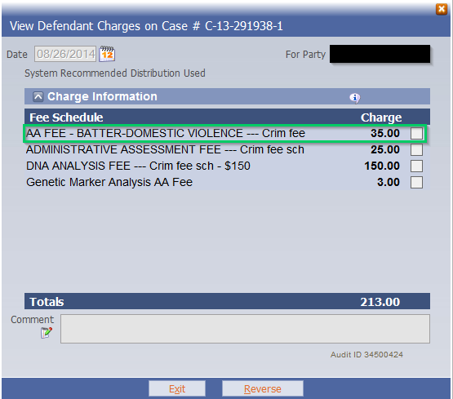
DV Fee: FY 2014 Collections
NRS | Description | Amount | Totals
200.485 | AA Fee Battery DV (STATE) | $ 35.00 | $ 538.33

Slide 17
Filing Trends – Civil / Criminal

Slide 18
Outstanding Balances – DC Criminal
DC Criminal Cases as of September 24th, 2014
Total # of Cases with Balance Due: | 130,374
Total Balance Due: | $84,038,264.35
Average Amount Due Per Case: | $644.59
DC Criminal Case Status Breakdown
Warrant | 2,639
Inactive | 310
Closed | 125,683
Open | 756
Re-Activated | 493
Re-Opened | 493
AA Fee Battery DV (STATE) Summary: Subset from the totals above
Total # of Cases with Balance Due: | 1,160
Total AA Fee Battery Balance Due: | $28,995.00

Slide 19
Outstanding Balances – DC Criminal
DC Criminal Cases as of September 24th, 2014
Total # of Cases with Balance Due: | 130,374
Total Balance Due: | $84,038,264.35
Average Amount Due Per Case: | $644.59
DC Criminal Cases Owing Breakdown
Total # Cases Owing < $50: | 51,740 = $1,283,556.26
Total # Cases Owing $50 - $999: | 72,068 = $15,407,686.83
Total # Cases Owing $1,000 - $1,999: | 3,063 = $4,019,063.32
Total # Cases Owing $2,000 - $2,999: | 1,904 = $4,168,746.56
Total # Cases Owing $3,000 - $3,999: | 143 = $486,922.72
Total # Cases Owing $4,000 - $4,999: | 139 = $624,343.66
Total # Cases Owing > $5,000: | 1,317 = $58,047,946.00

Slide 20
Thank You

Slide 21
Collection of Fines and Fees
Presented To:
The Advisory Commission On The Administration Of Justice’s Victims Of Crime Sub-Committee
Presented By:
Steven D. Grierson
Court Executive Officer
Eighth Judicial District Court

