Slide 1
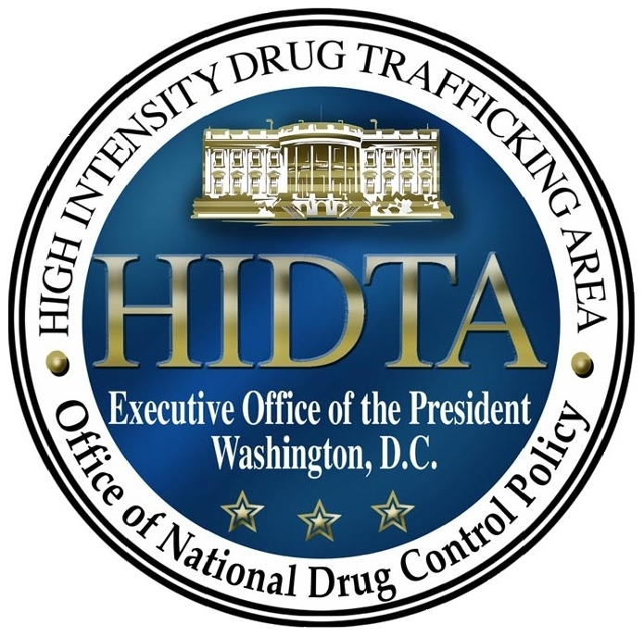
HIDTA
High Intensity Drug Trafficking Areas
Established in 1990 by Vice President Biden

Slide 2
Currently funded at
$3.2 million
WASHOE COUNTY 2006
CLARK COUNTY 2001
14 Enforcement Task Forces

Slide 3
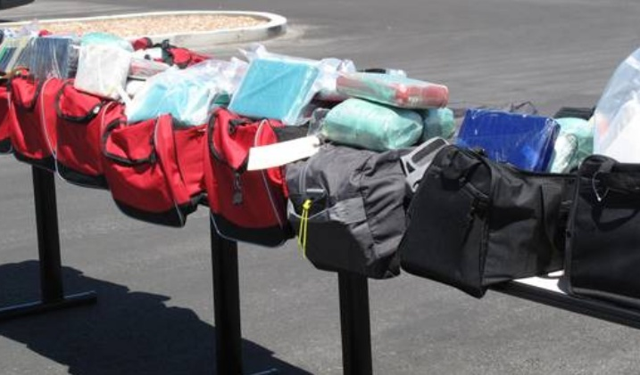
DRUG TRENDS
Cocaine
2006 – 135 kg
2010 – 70 kg
2011 (1st half) – 260 kg

Slide 4
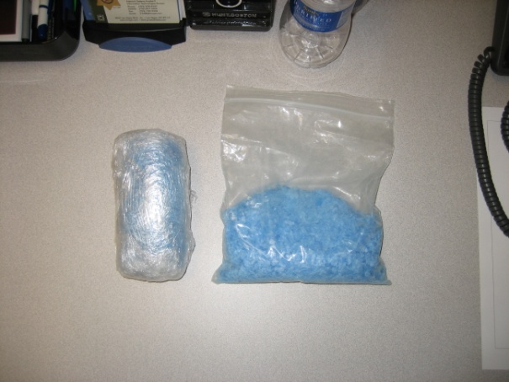
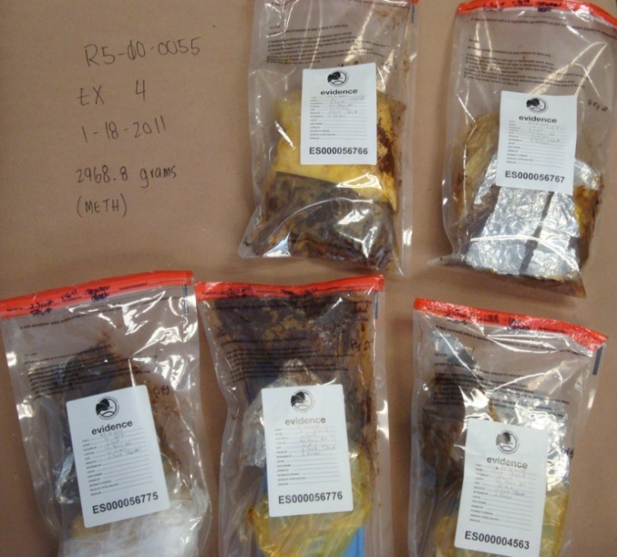
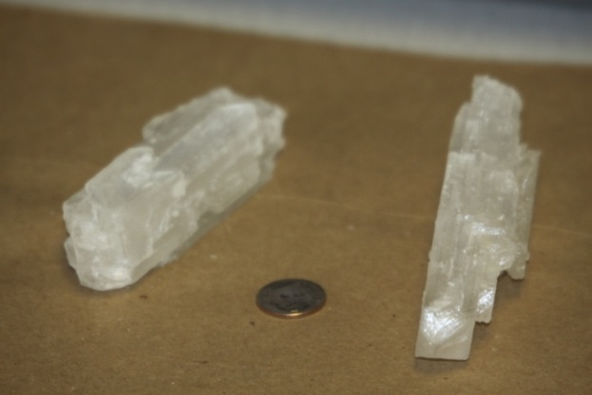
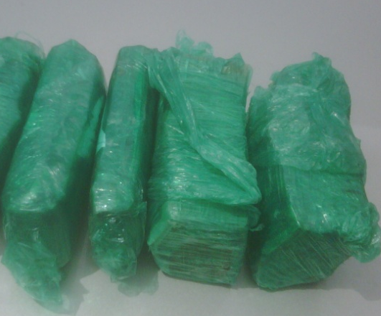
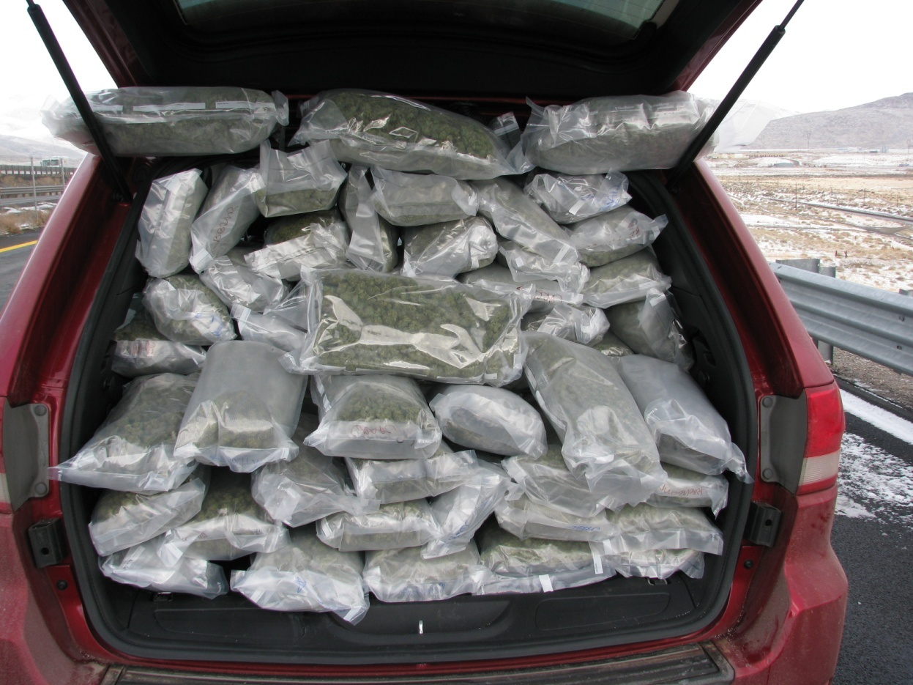
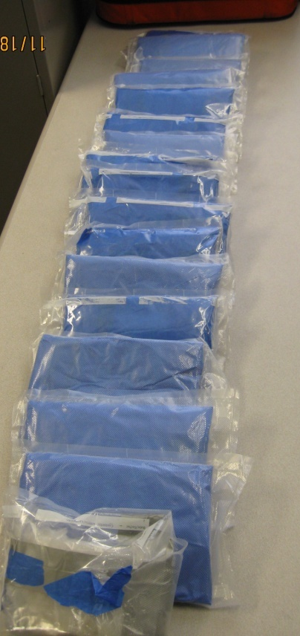
DRUG TRENDS
Methamphetamine
2006 – 105 kg
2010 – 145 kg
2011 (1st half) – 214 kg

Slide 5
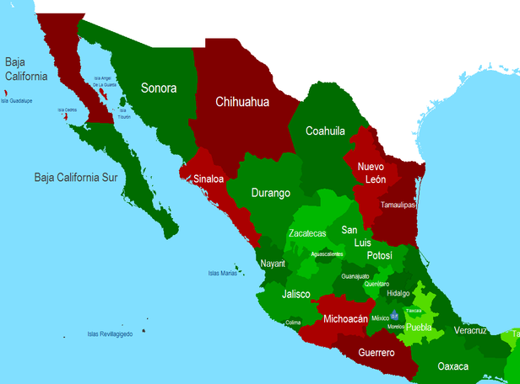
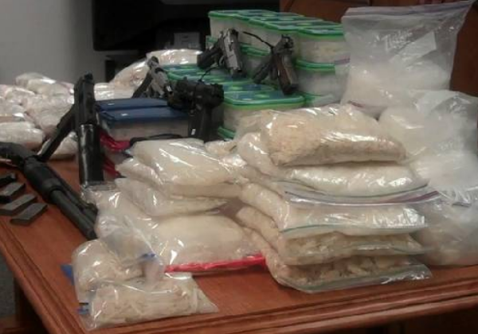
DRUG TRENDS
Cartels - 7

Slide 6
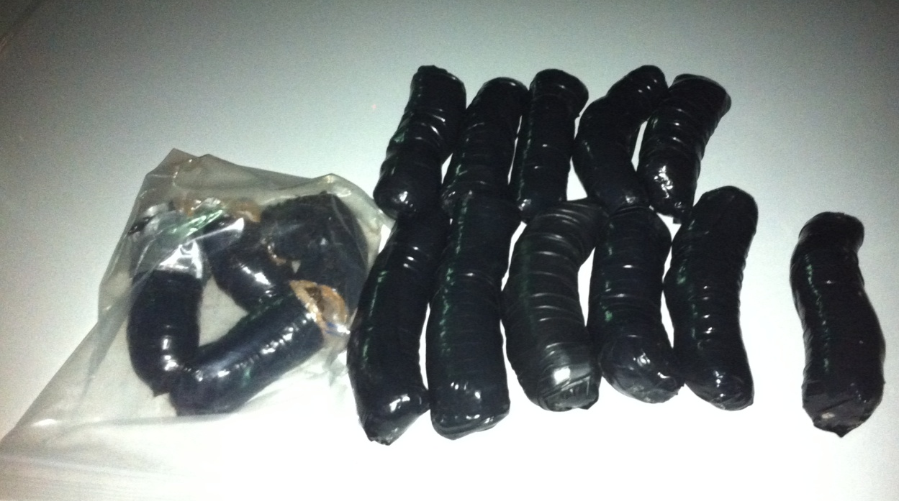
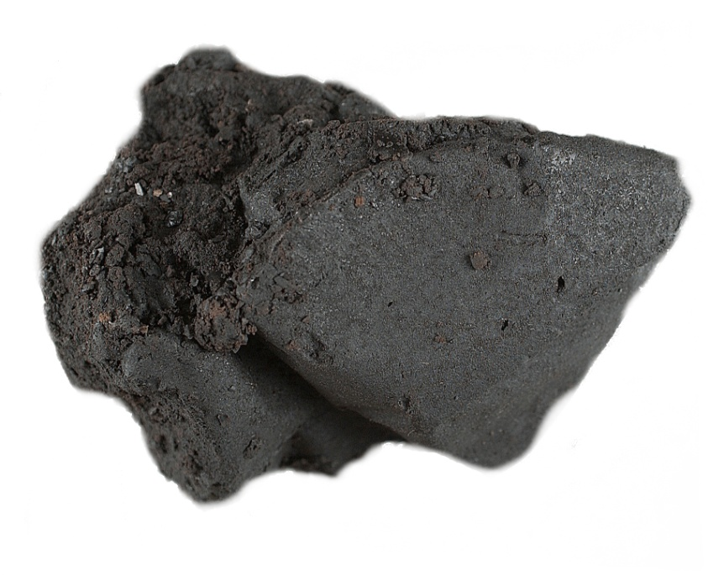
EMERGING TRENDS
Heroin
2007 – 1 kg
2010 – 15 kg
2011 (1st half) – 8 kg

Slide 7
EMERGING TRENDS
HIGH SCHOOL CONNECTION TO PHARMACEUTICALS

Slide 8
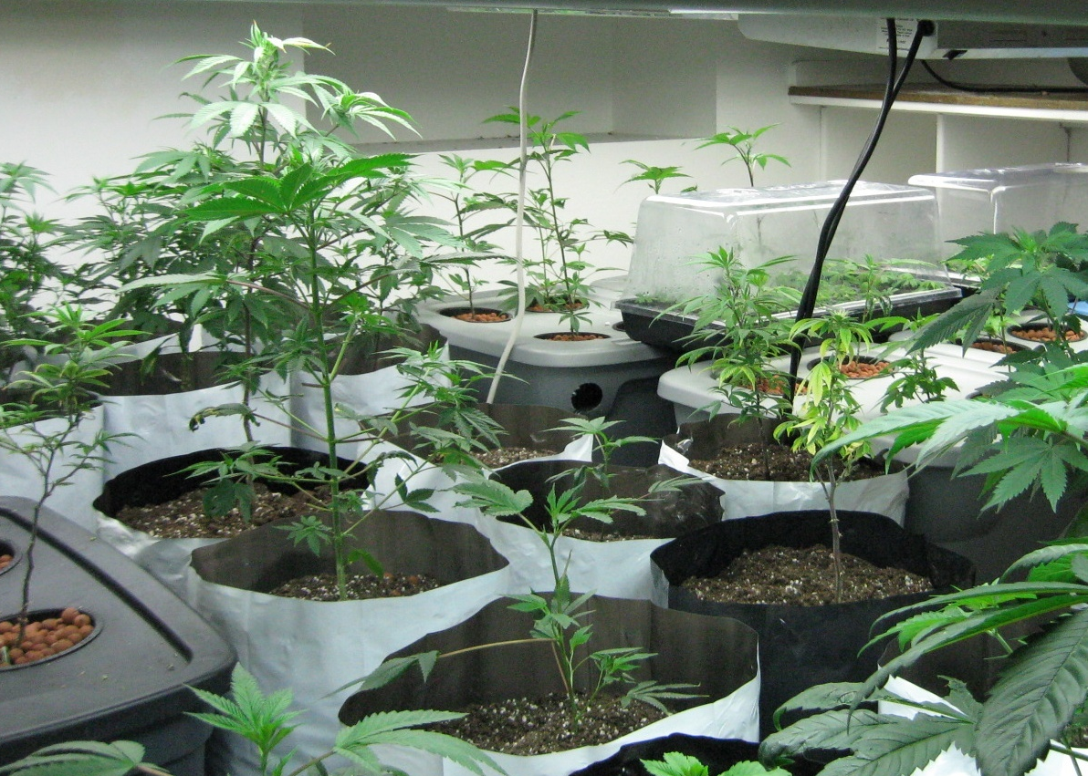
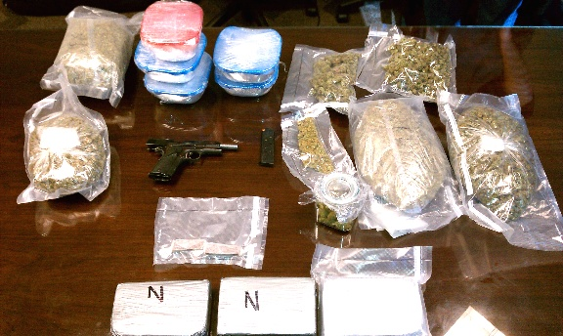
EMERGING TRENDS
Marijuana – Indoor Grows
2009 – 108
2010 – 134
2011 (1st half) – 129
8 % increase
Over 8,000 plants
Estimated value over $25.4 million

Slide 9
EMERGING TRENDS
Marijuana Indoor Grow Houses
Common in rental homes
Rarely anyone appears to be home
Visitors at odd hours—don’t stay long
Avoids contact with neighbors
Windows closed and covered
Condensation on windows
Equipment (fans, lights, potting soil) carried into house
Construction or electrical humming noises coming from within the house
Strange odors coming from house

Slide 10
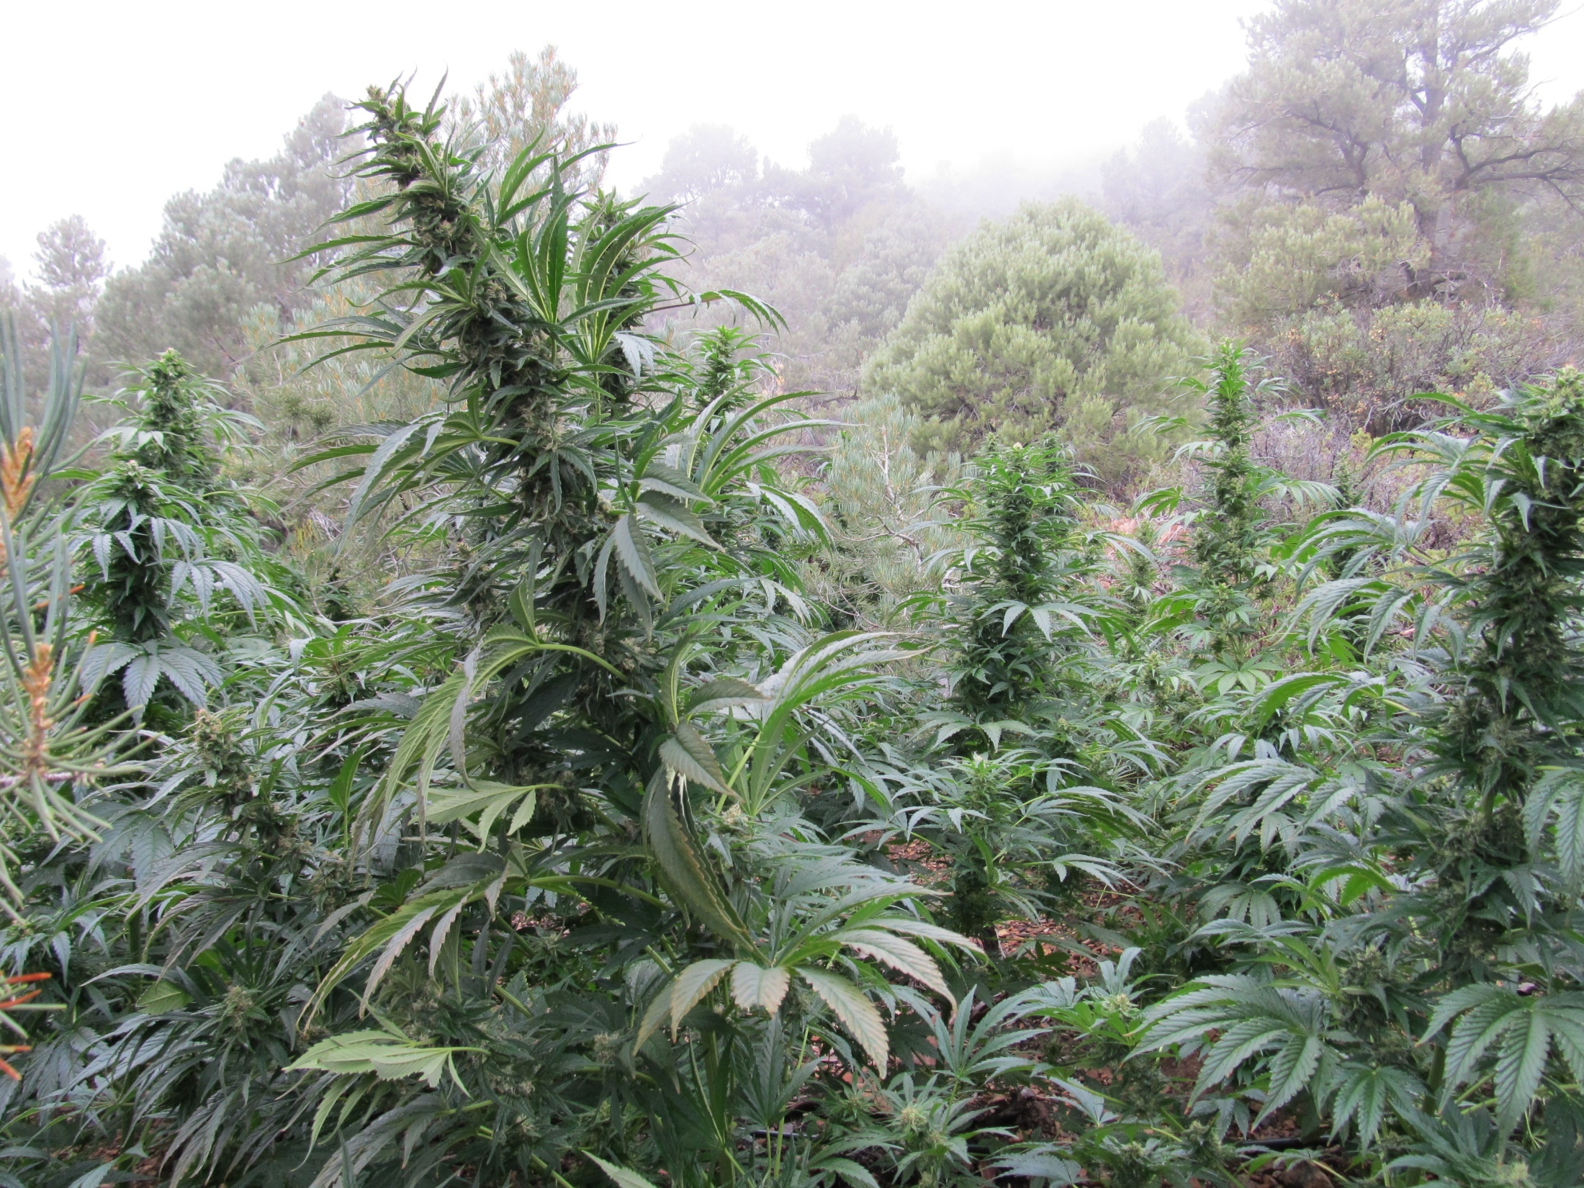
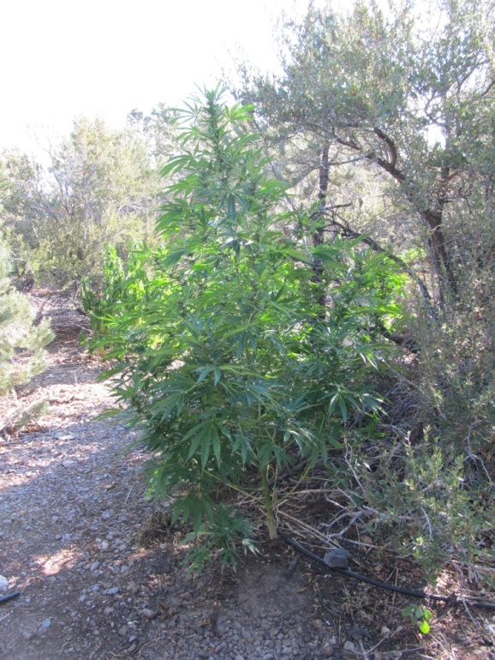
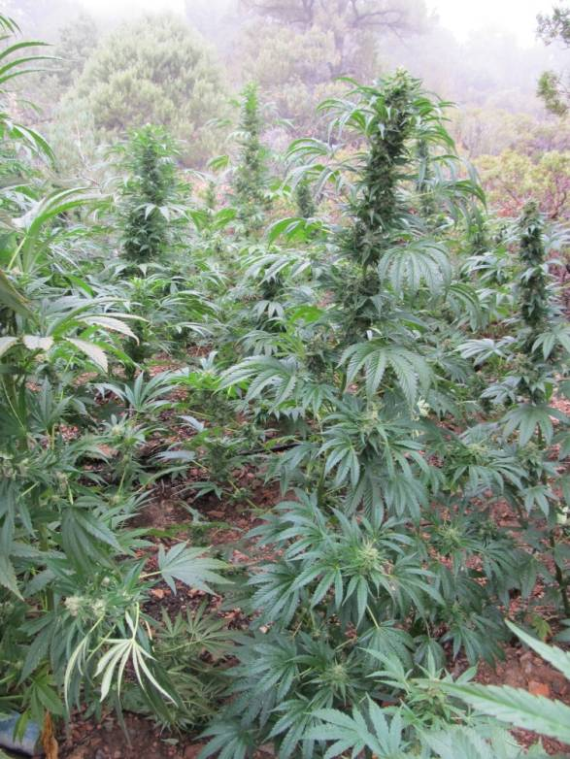
EMERGING TRENDS
Marijuana – Outdoor Grows
2010 – 1 grow (Washoe County)
2011 – 7 grows, over 59,000 plants

Slide 11
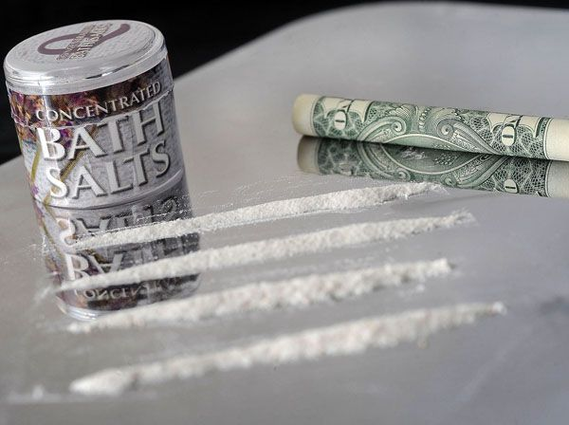
EMERGING TRENDS
Stimulants
“Ivory Wave”, “Purple Wave”, and “Bliss”
Manufactured in China, Pakistan, and India
“Cathinone” – active ingredient from the leaves of “Khat Plants”
Effects – meth, MDMA, and cocaine

